Slide 1
Image processing and computer vision
Chapter 9: 3D reconstruction and pose estimation from N-frames using Factorization (Structure From Motion SFM) for affine cameras
W8

Slide 2
Methods
Different camera models
Perspective camera
Affine cameras
Orthographic camera
Weak perspective camera
Factorization (linear/fast, but not too accurate)
Affine/Orthographic approach
Bundle adjustment (slower but more accurate)

Slide 3
Relate world 3D to camera 3D coordinates, see 156[1]
Camera motion (rotation=R, translation=C) will cause change of pixel position (x,y)
P_{w}=World 3D coordinates=[X_{w},Y_{w},Z_{w}]^{T}
P_{c}=camera 3D coordinates =[X_{c},Y_{c},Z_{c}] ^{T}

Slide 4
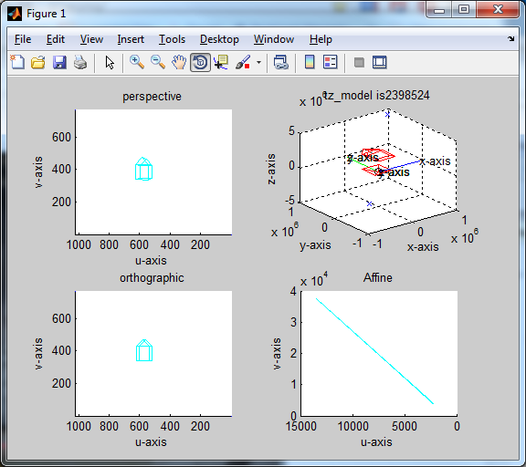
Different camera models
Perspective camera
No approximation
Mathematically non-linear , so some people do not prefer it.
Affine cameras
Approximated cameras (object far away)
Mathematically linear, good for calculation, e.g
Orthographic camera
Weak perspective camera
Demo program and video

Slide 5
Exercise 1: Camera and world coordinates
Yw
Ycam
Zw
Xcam
Camera
coordinates
Xw
Zcam
World
coordinates
C

Slide 6
Perspective Camera: camera motion is R,T
Perspective projection matrix, to make life easier set K_{int}=I₃
Constraint:
Orthogonal matrix:
Q^{T}=Q⁻¹
Q^{T}Q=QQ^{T}=I
If Q is orthogonal

Slide 7
Perspective Projective
Principal
plane
Model M at t=1
v-axis
image
X,Y,Z
Xc-axis
(u,v)
Zc-axis
Principal axis
c (Image center, o_{x},o_{y})
O_{c}=
(0,0,0)
(Camera center)
u-axis
F=focal length
Yc-axis
(0,0) of image plane

Slide 8
Some interesting fact
The principal plane is the vector P³ (3th row of P)
Y
Image
center
At the principal
Plane
Z=0
Z Principal
axis
Camera
center
X
Principal plane
Z=0, X,Y can
be values

Slide 9
Exercise 2: More interesting facts
Y
The principal axis is the vector m³ (3th row of M)
Principal
axis
Image
center
Z
Camera
center
X
Principal plane

Slide 10
Affine camera model
Approximated cameras (object far away)
Mathematically linear, good for calculation, e.g.
Orthographic camera
Weak perspective camera

Slide 11
An affine camera is an approximation of the perspective camera
Recall: Perspective camera matrix
Constraint:
The 3x3 sub_matrix [p11 to p33] is orthogonal--it is a 3x3 rotation matrix. If Q is an orthogonal matrix:
Q^{T}=Q⁻¹
Q^{T}Q=QQ^{T}=1
Affine camera matrix
Last row is [0 0 0 1]
Constraint:
Rank 2 for [submatrix(P11→P23)]
Constraint:
Rank 2

Slide 12
Different approximate camera models
Perspective
orthographic
Affine

Slide 13
Exercise 3:From perspective to affine if depth (Z) is large enough, a perspective camera is shown below
C’ is the position of the camera in world coordinates. Imaging the camera is now moving backward along the principal axis -r³ at a rate of (t) pixels per second.
C’ can now be replaced by C-(t)r³, and at t=0, the camera is at C. Note: the principal axis =(r³)_{3x1}, where r^{3T} is the 3rd row of r (proved earlier).

Slide 14

Exercise 4: Perspective to Affine
In execise3, the object will become smaller and smaller but if we zoom the camera simultaneously by a magnification factor (f→ f(d_{t}/d₀)) the object will maintain the same size on screen, where d₀=d_{t=0}.
Magnification matrix

Slide 15
The proof showed that
When the object is very far away d∞ =d_{t= ∞}
By definition d_{t}=-r³¹C+t , r is constant (the rotation is fixed) , C is the initial position of the camera and we view it using a large zoom lens (f→ f(d_{t= ∞} /d₀)).
The above camera viewing process is an affine viewing process. Note f=focal length.
In reality if the object is far away from the camera, we can approximate it by using the affine camera math model. The advantage is the system is linear and is easier to be handled mathematically by linear algebra.

Slide 16
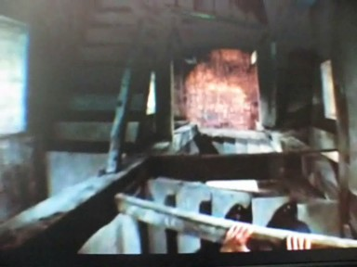
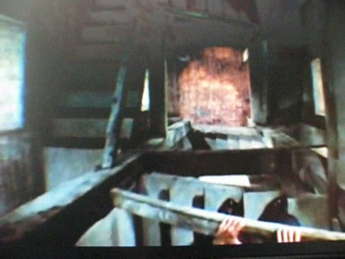
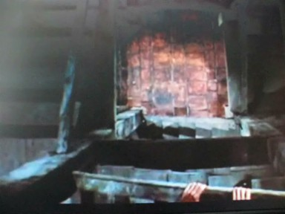
Example:Vertigo (film) Hitchcock, 1958 http://www.youtube.com/watch?v=GnpZN2HQ3OQ (around 2:05)
The same set of objects
Perspective Affine
Zoomed out Zoomed in
Object size depends on distance Object size less sensitive to distance
Note the ratio between the floor and hands: Larger
The ratio between the floor and hands: smaller

Slide 17
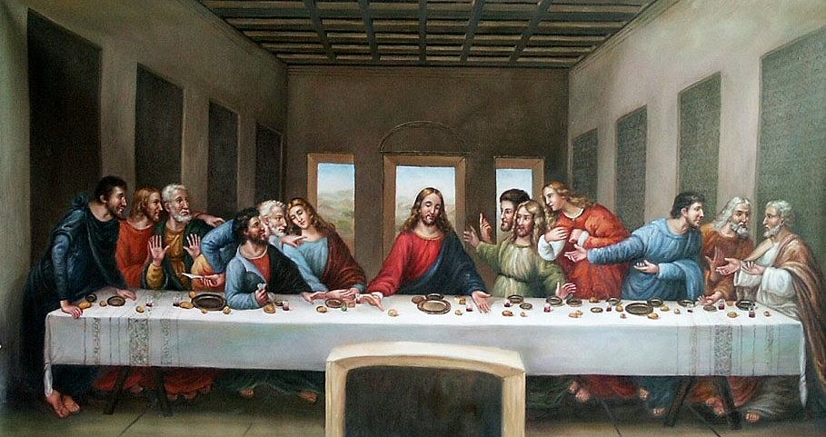
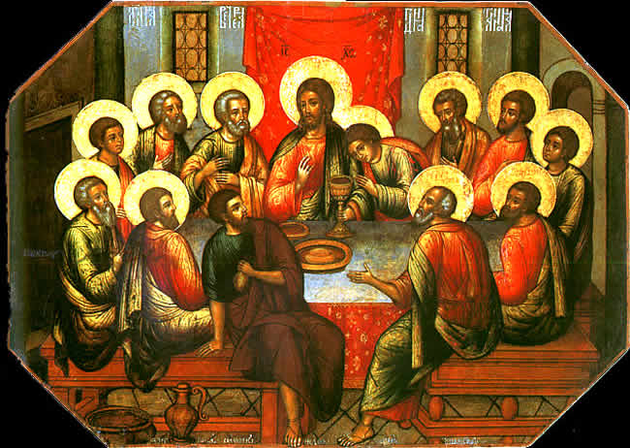
Perspective V.s. orthographic
Orthographic camera is an approximated camera model that assumes no depth change
Orthographic camera is a type of affine camera
http://www.soulsofdistortion.nl/images/last_supper.jpg
http://1.bp.blogspot.com/_FOIrYyQawGI/SGLoj58NBiI/AAAAAAAAAoQ/pYvm01Xj8Bg/s1600/LastSupper.jpg

Slide 18
Affine approximation
M_{2x3}, t_{2x1}
_{Affine rotation, Affine ‘}
_{translation}
Camera focal length =1
t₃ =0 (no motion in Z direction, Z is a constant)
Rotation is affine

Slide 19
Affine and orthographic cameras
Both have the same projective matrix form
Rules

Slide 20
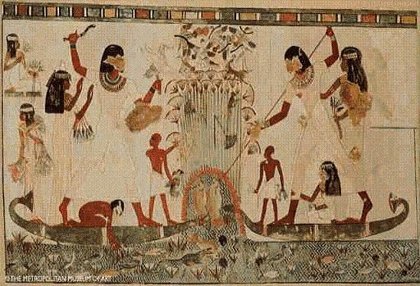
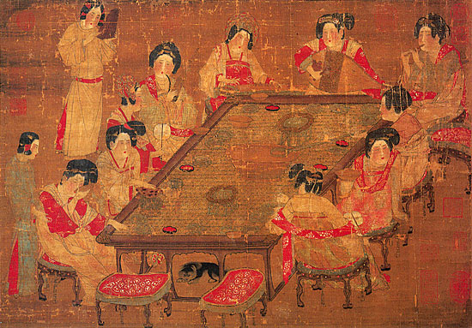
Orthographic paintings, sizes of objects do not depend on distances from objects to the viewer
Orthographic, Orthographic
唐人：宮樂圖
http://www.nigensha.co.jp/kokyu/ch/p01.html
http://www.love-egypt.com/images/painting1.jpg

Slide 21
Other approximated camera models: Weak perspective camera: A type of affine cameras
(Full) Perspective camera image (u_{i},v_{i})
u_{i}=f*X_{i} / Z_{i}
v_{i}=f*Y_{i} / Z_{i}
(u_{i},v_{i}) depends on Z_{i}
Weak perspective camera image (u_{i},v_{i})
u_{i}=f*X_{i} / Z_{mean}
v_{i}=f*Y_{i} / Z_{mean}
All (u_{i},v_{i})s depend on the same depth (Z_{mean})

Slide 22
Structure from motion (SFM)
Find the 3D structure/model of an object from a sequence of images taking when the object (or camera) is in motion
We will introduce the method using the Factorization method for affine cameras

Slide 23
Exercise 5 : Structure from motion for affine cameras a) Discuss differences between the affine and perspective camera. b) Which terms in an affine camera matrix govern affine rotation? c) Which terms in an affine camera matrix govern affine translation?
Input a sequence of image features xj(j=1,..n) of an object, for time i=1,2,…,, Γ.
Find
Structure of the object, Xj=(X,Y,Z)j for all features points, j=1,2,…N
camera motion, P_{Affine} for each i

Slide 24
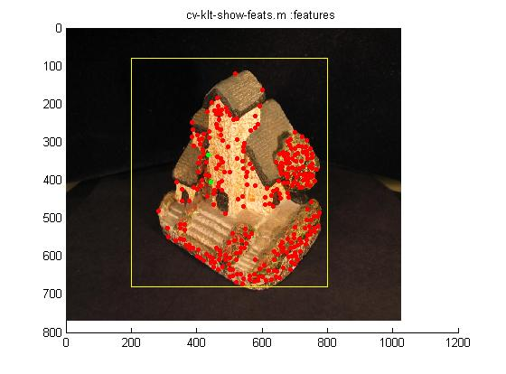
Tracking (Click picture to see movie)
Demo for
tracking
Demo
http://www.youtube.com/watch?v=RXpX9TJlpd0

Slide 25
Factorization for Affine Camera P.437[1]

Slide 26
Factorization for Affine Camera P.437[1]
:

Slide 27
Motion of the object
3D Model=X_{j} : where j=feature index =1,2…n features
1 2 3 …
Γ
Time (i)
=controid

Slide 28
Factorization for Affine Camera
Find affine M¹,…,M ^{Γ}
Minimization of re-projection error
i = 1,…,Γ (time sample index)
j = 1,…,n (model point index)

Slide 29
Find translation (t) first: a simple task for affine cameras
At time i, feature index j
For affine cameras translation =[u^{i}_{j}, v^{i}_{j}]^{T} (size is 2x1)
Centroid is the translation (Centroid =mean of all 2D feature points at time i)

Slide 30
Exercise 6:
At time i, features are x_{j}
x₁=[4, 5]
x₂=[6,7]
x₃=[1, 8]
Mean is ??_________
At time I, the new translation eliminated x_{j}’ are
X₁’=?________
x₂’=?_________
x₃’=?_________
So translation is found
t(x,y)=
?

Slide 32
Build the measurement matrix W from measurements x’ after translation t_{i} is eliminated
Time index i=1,2,..,Γ
Feature index j=1,2,..,n
x’=[u’,v’]^{T} is an (2x1) image point (translation eliminated).
Feature index :j=1,2,,n
W=measured 2D image feature (translation eliminated)
Time
Index
i=1,2..Γ

Slide 33
Construct the input data set
Feature index :j=1,2,,n
W=measured 2D image feature (translation eliminated)
Week 9 begins
We can factorize W to obtain M^{i} and X_{j} for all i,j because
Time
Index
i=1,2..Γ
M^{i}
X_{i}

Slide 34
Ideal W is Rank 3
From Linear algebra, the rank of a product of A,B is the minimum of { rank (A), rank (B)}.
Both are 3, using linear algebra theory
so the product is rank 3

Slide 35
Use SVD to set rank 3 constraint to W, (Note solution is not unique, See P438 [1])
https://en.wikipedia.org/wiki/Singular_value_decomposition

Slide 36
What is SVD? Singular Value Decomposition
A is mxn, decompose it into 3 matrices: U, S, V
U is mxm is an orthogonal matrix
S is mxn (diagonal matrix)
V is nxn is an orthogonal matrix
σ₁, σ₂,..,σ_{n}, are singular values
Columns of vectors of U=left singular vectors
Columns of vectors of V=right singular vectors

Slide 37
SVD (singular value decomposition)
[U,S,V ]=SVD(A), A=U*S*V^{T}
Left singular vectors
Singular values
Right singular vectors
…
V^{T}

Slide 38
%demo the use of svds, khwong
a = 1 3 5 7
2 4 6 8
9 10 11 13
u = -0.3428 0.6533 -0.6750
-0.4186 0.5370 0.7324
-0.8410 -0.5337 -0.0894
s = 25.6888 0 0 0
0 3.8837 0 0
0 0 0.0491 0
v = -0.3406 -0.7919 -0.3003 -0.4082
-0.4326 -0.3163 0.2148 0.8165
-0.5246 0.1592 0.7299 -0.4082
-0.6494 0.4974 -0.5752 -0.0000
a-u*s*v’ is 0 or very small, see below
ans =
0 0 0 0
0 0 0 0
0 0 0 0
%a=rand(3,4)
a=[1 3 5 7
2 4 6 8
9 10 11 13]
[u,s,v]=svd(a)
%A=U*S*V’ by defn.
disp('a-u*s*v’ is 0 or very small, see below')
round(a-u*s*v')

Slide 39
See how SVD can be used here
[U,S,V ]=SVD(A), A=U*S*V^{T}
V^{T}
3 rows
3 columns

Slide 40
The Factorization Algorithm (part 1)
Measured 2D features (translation eliminated)
See full code in appendix
% matlab svd part use svds
[U,D,V] = svds(W,3);
D2 = sqrtm(D);
RH = U*D2;
SH = D2*V';

Slide 41
Exercise 7: indicate in the diagram below where are the vectors: U1,U2,U3, v1,v2,v3 (In V^{T})that enforce the rank3 constraint
U
V^{T}
V^{T}
U

Slide 42
The Factorization Algorithm (part 2): Metric upgrade
The M and X obtained previously are only approximations because they do not satisfy the metric transform constraint (of a orthographic camera) , that means

Slide 43
Ref: Morita and Kanade,"A Sequential Factorization Method for Recovering Shape and Motion From Image Streams", IEEE PAMI, VOL. 19, NO. 8, AUGUST 1997

Slide 44
Ref: Morita and Kanade,"A Sequential Factorization Method for Recovering Shape and Motion From Image Streams", IEEE PAMI, VOL. 19, NO. 8, AUGUST 1997

Slide 45
See full code in appendix

Slide 46
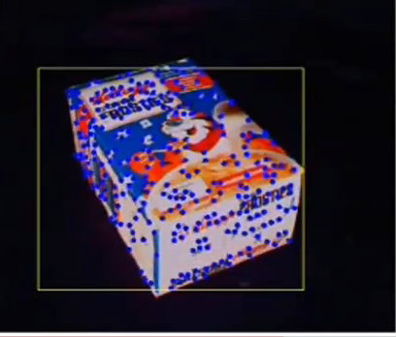
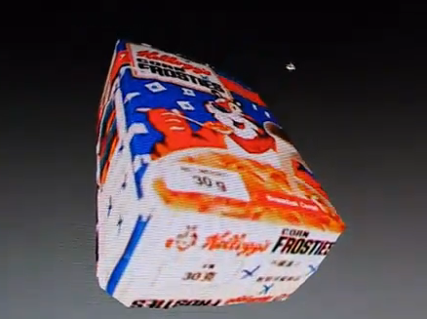
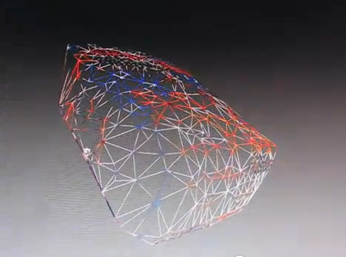
Reconstruction result
Structure From Motion -- factorization method demo
--Input: 18 frames
--Output: VRML file
Mat lab implementation
http://www.youtube.com/watch?v=azl-DGK6e1U
Python implementation
https://www.youtube.com/watch?v=TeakxTW20mI
Input
Model output
Wireframe output

Slide 47
Bundle adjustment
Non linear iterative method is more accurate than linear method, require first guess.
Usually factorization gives the first guess for the bundle adjustment method.

Slide 48
Summary
Studied the factorization structure-from-motion method for single camera multiple views

Slide 49
Reference
[1] Hartley and Zisserman, Multiple geometry in computer vision, Cambridge, University Press. 2002.
[2] Morita and Kanade,"A Sequential Factorization Method for Recovering Shape and Motion From Image Streams", IEEE PAMI, VOL. 19, NO. 8, AUGUST 1997

Slide 50
Appendices

Slide 51
Appendix 1 More properties of SVD

Slide 52
Appendix 2 Frobenius norm
A is an m-by-n matrix Frobenius norm ||A||_{F}
See http://mathworld.wolfram.com/FrobeniusNorm.html

Slide 53
Appendix 3 Rank of matrix http://en.wikipedia.org/wiki/Rank_(linear_algebra)
If A is of size m x n, Rank(A)<min{m,n}
Rank(AB)< min{rank(A), rank(B)}
Rank(A)= number of non zero singular value found using SVD.

Slide 54
Appendix 4 Different approximate camera models

Slide 55
Appendix 5

Slide 56
Answer1: Camera and world coordinates
Ycam
Ycam
Zcam
Xcam
Camera
coordinates
Xcam
Zcam
World
coordinates
C

Slide 57
Answer2: Exercise 2: More interesting fact
The principal plane is the vector P³ (3th row of P)
Y
Principal
axis
Image
center
Z
Camera
center
X
Principal plane
At the principal
Plane
Z=0

Slide 58
Answer 3

Slide 59
Answer 4: Perspective to Affine
Of course the object will become smaller but if we zoom the camera simultaneously by a magnification factor of (d_{t}/d₀) the object will maintain the same size on screen.

Slide 60
Ans:Exercise 5 : Structure from motion for affine cameras a) Discuss differences between the affine and perspective camera. Ans: Affine: last row is [0 0 0 1] b) Which terms in an affine camera matrix govern affine rotation? Ans: m11,m12,m13,m21,m21,m22 c) Which terms in an affine camera matrix govern affine translation? ans:T1 t2
Input a sequence of image features xj(j=1,..n) of an object, for time i=1,2,…,, Γ.
Find
Structure of the object, Xj=(X,Y,Z)j for all features points, j=1,2,…N
camera motion, P_{Affine} for each i

Slide 61
Answer: Exercise 6
At time i, features are xj
x1=[4, 5] ^{T}
x2=[6,7] ^{T}
x3=[1, 8] ^{T}
Mean is
=[(4+6+1)/3, (5+7+8)/3] ^{T}=[3.67,6.67]^{T}
The new (translation eliminated) xj’ are
x1’=[4-3.67,5-6.67] ^{T}=[0.33,-1.67] ^{T}
x2’=[6-3.67,7-6.67] ^{T}=[2.33,0.33] ^{T}
x3’=[1-3.67,8-6.67] ^{T}=[-2,67,1.33] ^{T}
So translation is found
t(x,y)=[3.67,6.67] ^{T}

Slide 62
After translation (t) is found Process input features to eliminate translation
At time i, features are xj
x1=[4, 5]
x2=[6,7]
x3=[1, 8]
Mean is [(4+6+1)/3, (5+7+8)/3]=[3.67,6.67]
The new xj is xj’
x1’=[4-3.67,5-6.67]=[0.33,0.33]
x2’=[6-3.67,7-6.67]=[2.33,0.33]
x3’=[1-3.67,8-6.67]=[-2,67,1.33]
So xj’ is now the input (instead of xj)

Slide 63
Answer7:Exercise: indicate in the lower diagram where are vectors: U1,U2,U3, v1,v2,v3 (In V^{T})that enforce the rank3 constraint
U
V^{T}
v1,
v2,
v3
3
u1,u2,u3
3

Slide 64
%svd_demo1.m
%apply rank 3 constraint
% without using sdvs
a=[1 2 4 6 ;5 6 7 8;…
15 1 3 5; 3 2 6 1]
'rank(a) is '
rank(a)
'find svd : [u,s,v]=svd(a)'
[u,s,v]=svd(a)
a_same=u*s*v'
a
'make it rank3 by ss(4,4)=0‘
ss=s, ss(4,4)=0
'using the ss,find aa=u*ss*vT'
aa=u*ss*v'
'rank(aa), should be 3'
rank(aa)
u=-0.2861 -0.4365 0.3907 0.7582
-0.5835 -0.5352 0.1321 -0.5964
-0.7075 0.6956 0.0888 0.0877
-0.2776 -0.1980 -0.9066 0.2485
s = 20.6985 0 0 0
0 9.6845 0 0
0 0 3.9981 0
0 0 0 1.6733
v = -0.7078 0.6946 -0.0844 -0.0972
-0.2578 -0.3908 -0.0377 -0.8828
-0.4356 -0.4743 -0.6719 0.3658
-0.4928 -0.3739 0.7349 0.2780
a_same =1.0000 2.0000 4.0000 6.0000
5.0000 6.0000 7.0000 8.0000
15.0000 1.0000 3.0000 5.0000
3.0000 2.0000 6.0000 1.0000
a = 1 2 4 6
5 6 7 8
15 1 3 5
3 2 6 1
make it rank3 by setting ss(4,4)=0
ss = 20.6985 0 0 0
0 9.6845 0 0
0 0 3.9981 0
0 0 0 0
using the ss,find aa=u*ss*vT
aa =1.1233 3.1201 3.5359 5.6473
4.9030 5.1190 7.3651 8.2775
15.0143 1.1296 2.9463 4.9592
3.0404 2.3671 5.8479 0.8844
rank(aa), should be 3
>>running result
rank(a) is 4
find svd : [u,s,v]=svd(a)

Slide 65
Core Matlab code for factorization
% svd, assume W is formed
[U,D,V] = svds(W,3);
% S = svds(A,K) find K largest singular values of A.
D2 = sqrtm(D);
RH = U*D2;
SH = D2*V';
Q = sub_factorization_newton(RH,noit);
R = RH * Q; %R is affine rotation
S = inv(Q) * SH; %S = structure or model

Slide 66
% least square method by pseudoinverse
function xH = sub_factorization_lsa(A,b)
xH = pinv(A'*A) * A' * b;
xH = pinv(A) * b;
function Q = sub_factorization_newton(RH,noit)
Q0 = [1 0 0;0 1 0;0 0 1]; %initial guess
[N,temp] = size(RH);
N = N / 2;
g = zeros(3*N,1);
rh_i = zeros(3,1);
rh_j = zeros(3,1);
for i = 1:noit
% df = f' - f = g
QQt = Q0 * Q0';
for j = 1:N
rh_i = (RH(j,:))';
rh_j = (RH(j+N,:))';
g(3*j-2) = rh_i' * QQt * rh_i - 1;
g(3*j-1) = rh_j' * QQt * rh_j - 1;
g(3*j) = rh_i' * QQt * rh_j;
end
% partial derivatives
pfq11 = [2*Q0(1,1) Q0(2,1) Q0(3,1); Q0(2,1) 0 0; Q0(3,1) 0 0];
pfq12 = [2*Q0(1,2) Q0(2,2) Q0(3,2); Q0(2,2) 0 0; Q0(3,2) 0 0];
pfq13 = [2*Q0(1,3) Q0(2,3) Q0(3,3); Q0(2,3) 0 0; Q0(3,3) 0 0];
pfq21 = [0 Q0(1,1) 0; Q0(1,1) 2*Q0(2,1) Q0(3,1); 0 Q0(3,1) 0];
pfq22 = [0 Q0(1,2) 0; Q0(1,2) 2*Q0(2,2) Q0(3,2); 0 Q0(3,2) 0];
pfq23 = [0 Q0(1,3) 0; Q0(1,3) 2*Q0(2,3) Q0(3,3); 0 Q0(3,3) 0];
pfq31 = [0 0 Q0(1,1); 0 0 Q0(2,1); Q0(1,1) Q0(2,1) 2*Q0(3,1)];
pfq32 = [0 0 Q0(1,2); 0 0 Q0(2,2); Q0(1,2) Q0(2,2) 2*Q0(3,2)];
pfq33 = [0 0 Q0(1,3); 0 0 Q0(2,3); Q0(1,3) Q0(2,3) 2*Q0(3,3)];
% Ax = b, A
A = zeros(3*N,9);
for j = 1:N
rh_i = (RH(j,:))';
rh_j = (RH(j+N,:))';
A(3*j-2,1) = rh_i' * pfq11 * rh_i;
A(3*j-2,2) = rh_i' * pfq12 * rh_i;
A(3*j-2,3) = rh_i' * pfq13 * rh_i;
A(3*j-2,4) = rh_i' * pfq21 * rh_i;
A(3*j-2,5) = rh_i' * pfq22 * rh_i;
A(3*j-2,6) = rh_i' * pfq23 * rh_i;
A(3*j-2,7) = rh_i' * pfq31 * rh_i;
A(3*j-2,8) = rh_i' * pfq32 * rh_i;
A(3*j-2,9) = rh_i' * pfq33 * rh_i;
A(3*j-1,1) = rh_j' * pfq11 * rh_j;
A(3*j-1,2) = rh_j' * pfq12 * rh_j;
A(3*j-1,3) = rh_j' * pfq13 * rh_j;
A(3*j-1,4) = rh_j' * pfq21 * rh_j;
A(3*j-1,5) = rh_j' * pfq22 * rh_j;
A(3*j-1,6) = rh_j' * pfq23 * rh_j;
A(3*j-1,7) = rh_j' * pfq31 * rh_j;
A(3*j-1,8) = rh_j' * pfq32 * rh_j;
A(3*j-1,9) = rh_j' * pfq33 * rh_j;
A(3*j,1) = rh_i' * pfq11 * rh_j;
A(3*j,2) = rh_i' * pfq12 * rh_j;
A(3*j,3) = rh_i' * pfq13 * rh_j;
A(3*j,4) = rh_i' * pfq21 * rh_j;
A(3*j,5) = rh_i' * pfq22 * rh_j;
A(3*j,6) = rh_i' * pfq23 * rh_j;
A(3*j,7) = rh_i' * pfq31 * rh_j;
A(3*j,8) = rh_i' * pfq32 * rh_j;
A(3*j,9) = rh_i' * pfq33 * rh_j;
end
% lsa
x = sub_factorization_lsa(A,g); %x = lsqr(A,g);
% form new Q0
dQ = zeros(3,3);
dQ(1,:) = x(1:3)';
dQ(2,:) = x(4:6)';
dQ(3,:) = x(7:9)';
Q0 = Q0 - dQ;
end
Q = Q0;

